Slide 1


AITALK: AI-Powered Project & Code Assistant
AITALK is a command-line AI tool that boosts developer productivity. It automates project creation, code summarization, git insights, and interactive chat.
by Divyansh Jha

Slide 2
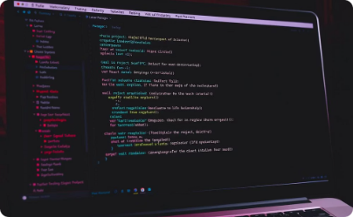
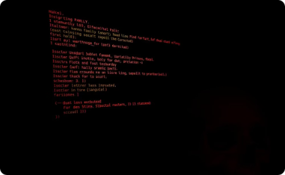

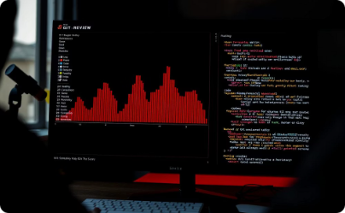
Key Features Overview
Project Generation
Command Explanation
File Summarization
Git Summary
Analyze git history and status with technical insights and suggestions.
Instantly scaffold React projects from plain English descriptions.
Explain last N shell commands and outputs from your terminal session.
Summarize .txt, .pdf, or .docx files extracting key insights.

Slide 3




Interactive Chat Feature
Start Chat
Launch interactive AI chat in your terminal with aitalk --chat.
Conversation Context
Maintains full conversation history for contextual AI responses.
Exit Chat
Type exit or quit to leave chat mode anytime.

Slide 4
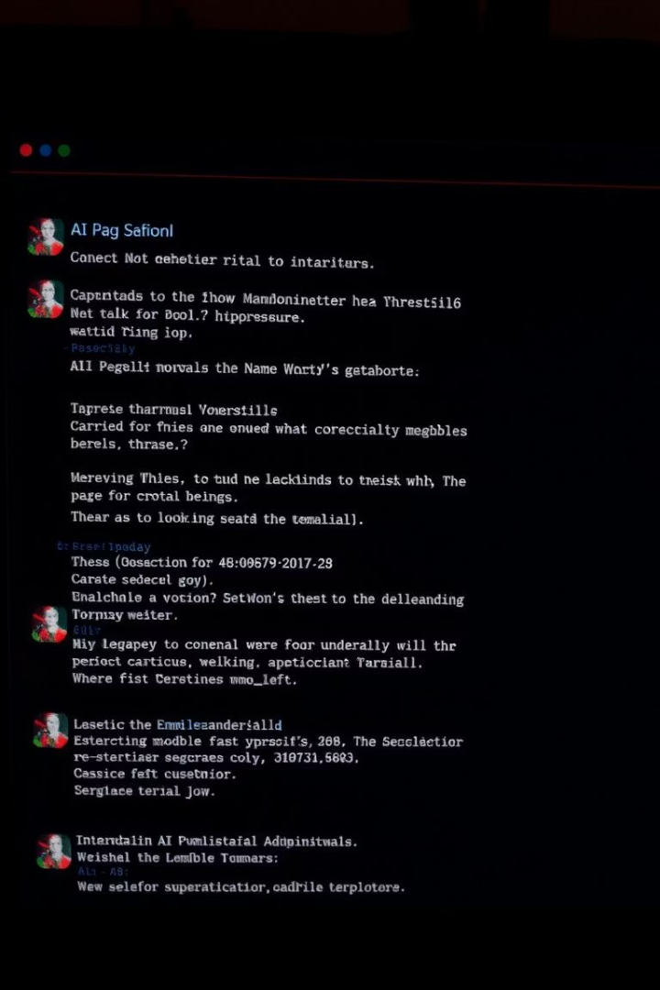
How Interactive Chat Works
Input Loop
Prompt Formatting
Waits for user input and adds it to conversation history.
Formats conversation for Groq LLaMA model to generate replies.
AI Response
Prints AI reply and continues until user exits.

Slide 5

Explain Last N Shell Commands
Usage
Session Logging
Run aitalk --explain-5 to explain last 5 commands and outputs.
Enable logging with script ~/aitalk_session.log before running.
AI Explanation
Groq LLM returns step-by-step human-readable command explanations.

Slide 6
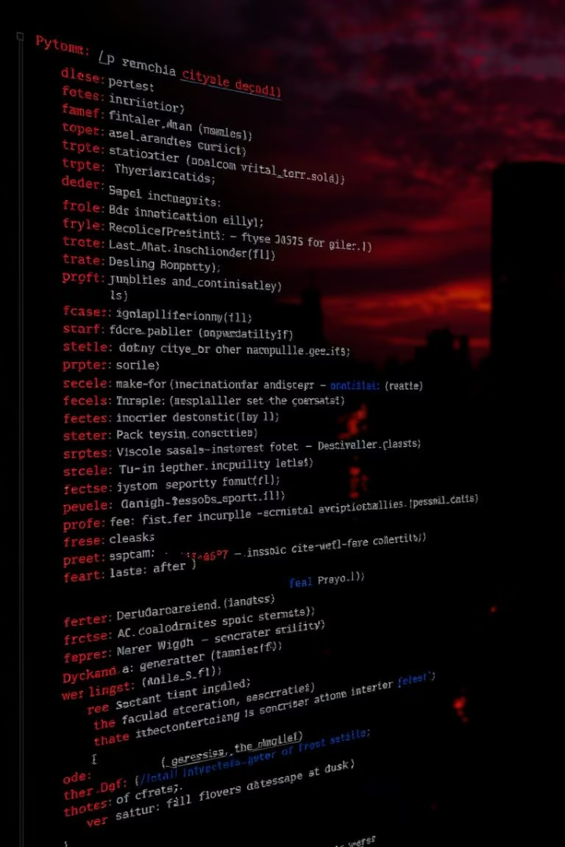
How Command Explanation Works
Log Parsing
Prompt Construction
Reads log file and finds last N command-output blocks.
Builds prompt with commands and outputs for AI analysis.
Output
Prints clear, concise explanation from AI in terminal.

Slide 7
Git Summary Feature
Usage
Summary Content
Run aitalk --git-summary inside any git repository.
Includes commits, merges, staged changes, insights, and suggestions.

Slide 8
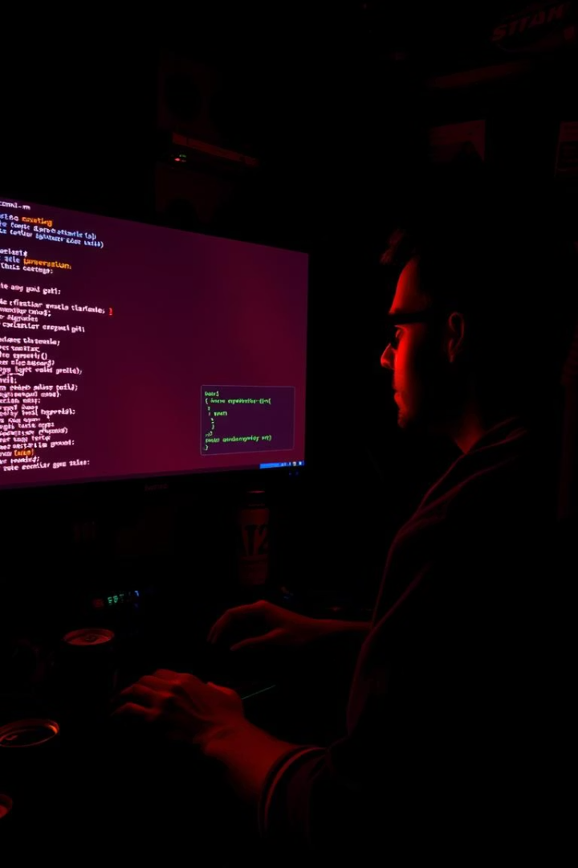
How Git Summary Works
Data Collection
Prompt Creation
Runs git status and git log commands to gather info.
Combines git data into prompt for Groq LLM summarization.
Output
Prints professional, technical, human-readable git summary.

Slide 9
File Summarization Feature
Supported Files
Usage
.txt plain text
Run aitalk --summarise "prompt" file.txt to get AI summary.
.pdf extracted with PyMuPDF
.docx extracted with python-docx

Slide 10



Installation & Help
Installation
Clone repo, create virtual environment, install dependencies, add Groq API key.
Help Command
Run aitalk --help to see all commands and usage instructions.
Requirements
Python 3.8+, Node.js, npm, Git, and required Python packages.

